Slide 1
There’s Gold in Them Thar Hills
Ben Langhinrichs
President of Genii Software

Slide 2
Our Amazing Sponsors

Slide 3
Introduction
Ben Langhinrichs President, Genii Software
Author, thinker, poet, software designer

Slide 4
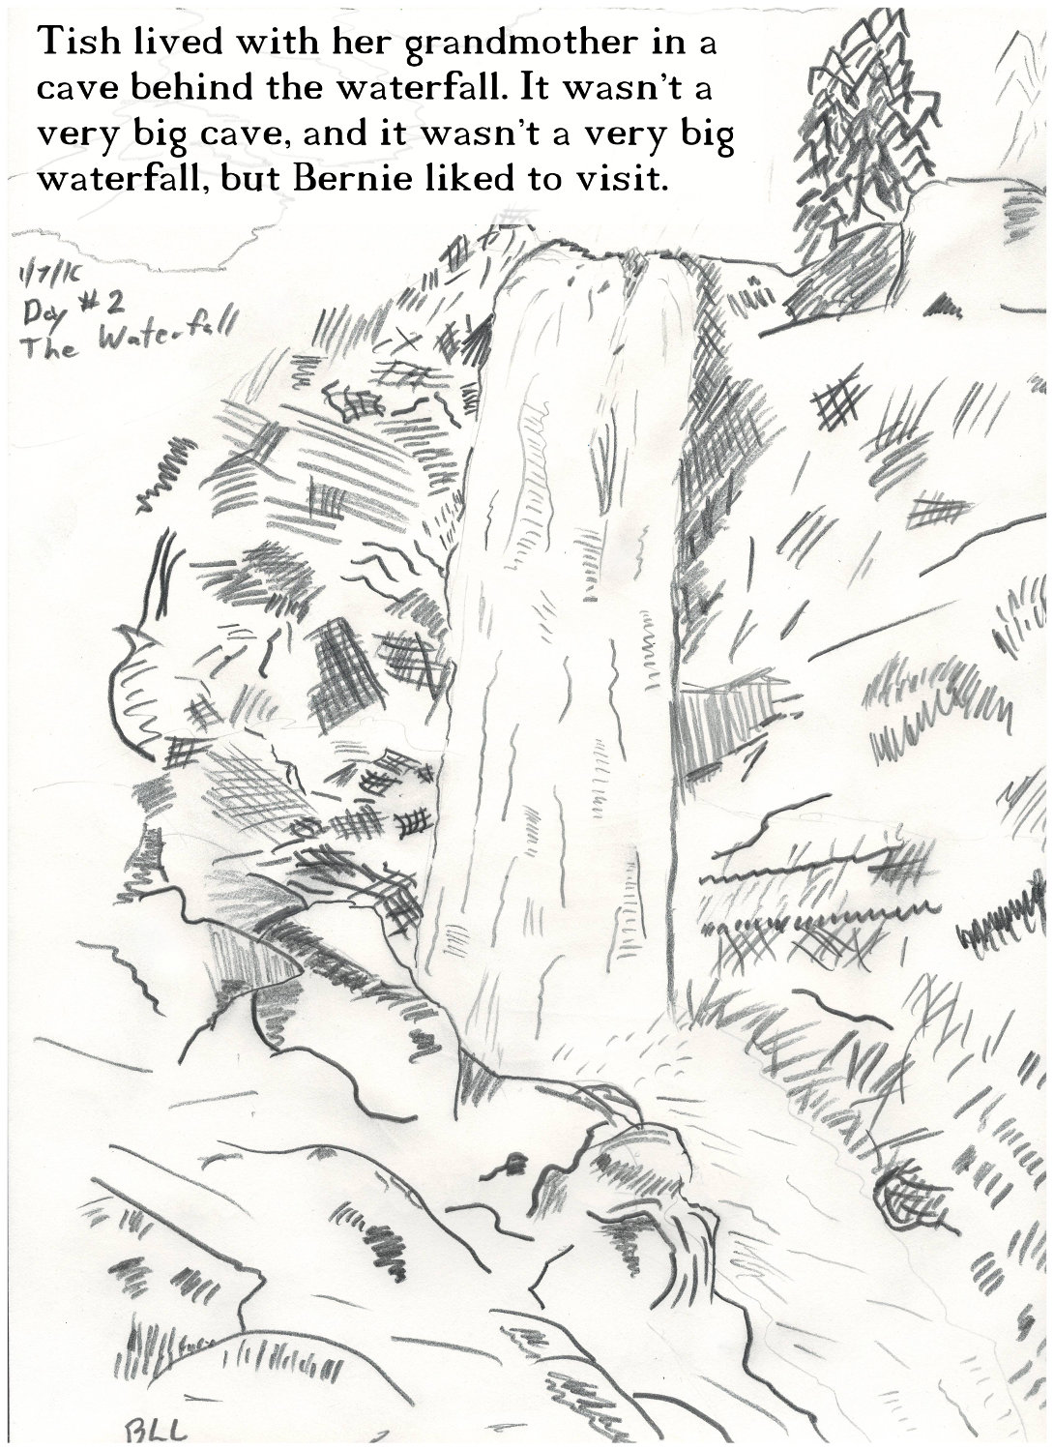
When I am not developing software, I write children’s books and draw pictures.
DANGER TASTES DREADFUL is due out in 2018 from Clean Reads (imprint of Astraea Press).

Slide 5
Genii Software products
CoexLinks family – high fidelity email
CoexLinks Fidelity – High fidelity email “live”
CoexLinks Migrate – High fidelity email exported
CoexLinks Journal – High fidelity email journaled to vaults
AppsFidelity family – high fidelity apps
AppsFidelity – Synchronized Notes/Web editing
AppsFidelity Migrate – Export application data
Midas family – extended programming in ND
Midas LSX – Data mining & export, rich text manipulation, and Holy crap, it does that, too?
Midas C++ - Same Midas magic squeezed into a C/C++ bottle

Slide 6
Data Mining. Really, how hard can it be?

Slide 7
Thoughts for session
Defining terms
What are the questions?
What are the logical units of information?
Data visualization
Data analysis with real world data
Machine learning with real world data

Slide 8
Defining terms
Data mining: digging into databases in order to find relevant information including context.
Data analysis: inspecting, cleaning, transforming, and modeling data with goal of discovering useful information, suggesting conclusions, and supporting decision-making
Data visualization: helping frame the significance of data by placing it in a visual context.
Machine learning: teaching computers to find hidden insights without being explicitly programmed where to look.

Slide 9
Data mining
Digging into existing data to find and extract valuable nuggets without losing important context.
But remember, while underground, gold and diamonds look worthless.

Slide 10
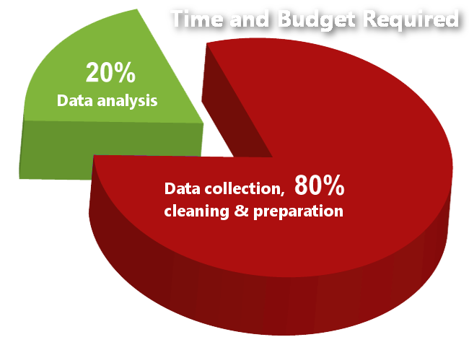
Data analysis
Answering questions and finding correlations based on numeric and quantitative analysis.

Slide 11
Data visualization
Telling a story in a way that allows viewers to understand an answer without doing the analysis themselves.

Slide 12
Machine learning / cognitive computing
Combining structured, unstructured and narrative data using natural language
The system learns as it is fed more data, so it can answer new questions & find new insights
Qualitative analysis with confidence rankings

Slide 13
Data mining - What are the questions?
Free associate. Brainstorm what kinds of questions you might want answered.
Avoid self-editing. Don’t be afraid to ask questions you don’t think are easily answered.
Avoid answers. Use your questions to define scope and logical units. If you can easily answer the question already, it may not be useful.

Slide 14
Data mining - Logical units of information

Slide 15
Data mining - Methods to extract data
How to get at it
LotusScript classes including NotesRichText classes
DXL
Third party tools
C API
What to do with results
Work inside of Notes by saving structured data to separate items or documents in a report database
Work outside of Notes by extracting structure into CSV, JSON, SQL db or whatever

Slide 16
Data visualization example (using Notes rich text data)
Uses existing database (Partner Forum 2004)
Counts on familiarity of audience
Emphasizes most important data without showing every detail
Over 25,000 documents

Slide 17
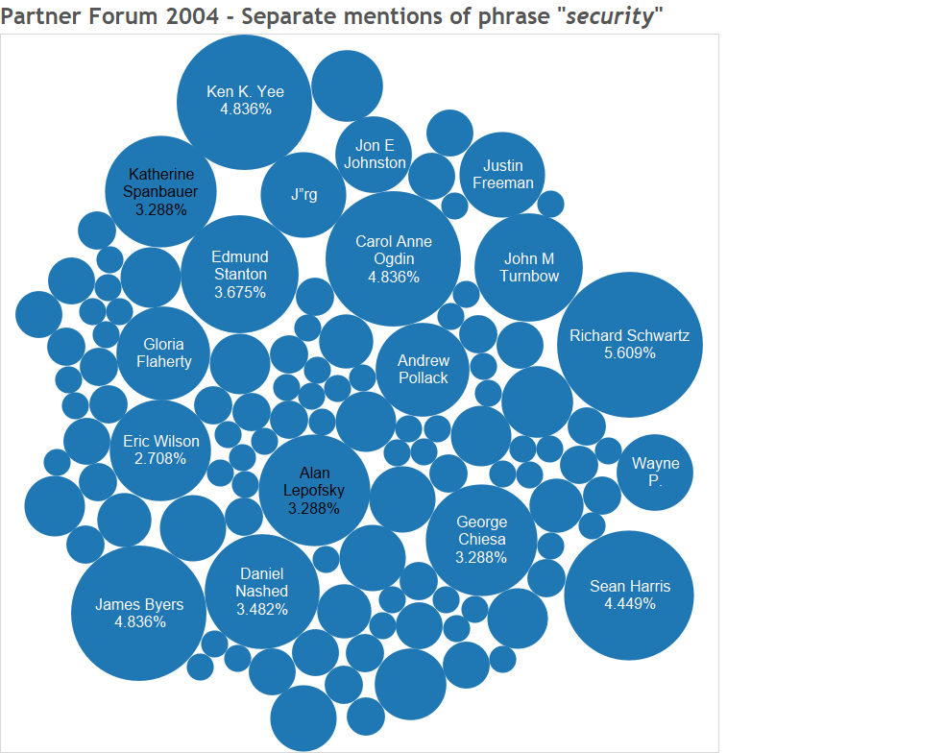
Visualization example

Slide 18
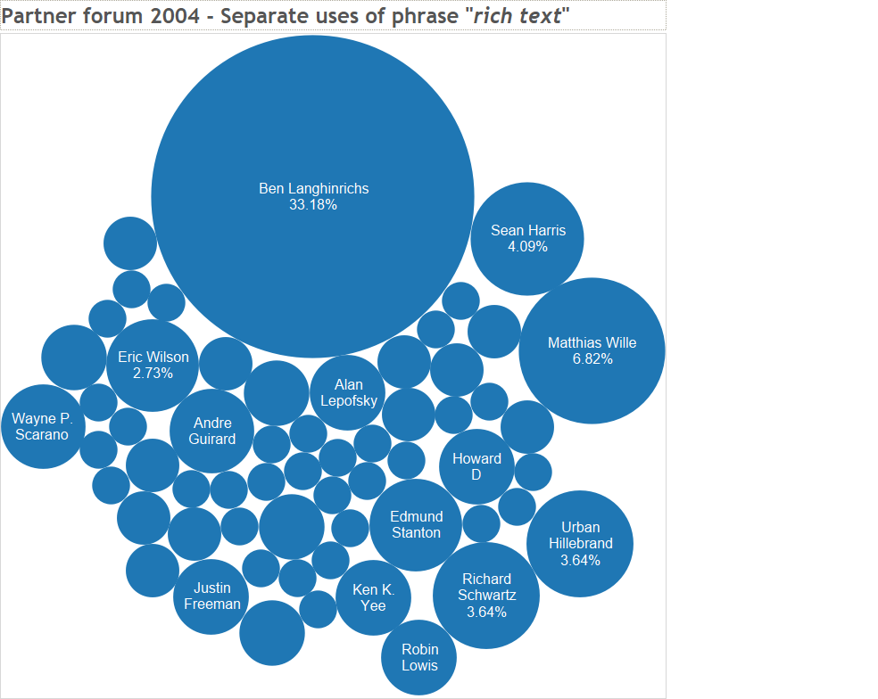
Visualization example

Slide 19
Unstructured to Structured
Notes data is technically unstructured
Some data is functionally structured
Some data is semi-structured
Some data is functionally unstructured
Data analytics needs structured data
Discrete values (names, categories, attributes)
Boolean values (yes/no, 0/1, black/white)
Numbers (it’s all about the numbers!)

Slide 20
Unstructured to Structured

Slide 21
Unstructured to Structured

Slide 22
Unstructured to Structured
Don’t forget the related data
Quantity of each type of fruit
Total weight of each type of fruit
Age of each shipment, percentage bad, etc. etc. etc.

Slide 23
Multi-Value Logical units in documents
Fields
Separate fields could be separate units
Multi-value field could be one unit per value (especially linked to other documents)
Rich text
Sections
Tables or table rows
Paragraphs
List items
Images
Attachments, including contents

Slide 24
Narrative data for Cognitive
Thursday, oranges were twice the price of the week before, and the quality was iffy. Supplier told us that Hurricane Rohit wiped out most of the citrus crop. On the other hand, they had some good Granny Smith and Macintosh apples, so we doubled up to 40 crates on those and only got three of oranges. We need to get an apple pie recipe in the weekly flier. – Ron in purchasing
Granny Smiths are very tart, but Janice found a recipe which uses them. If it works, we’ll double up on apples next week as well. – Javier (supervisor)

Slide 25
Tools of the trade
There are various tools for finding data:
Notes views
Exporting a view to CSV
Extracting rich text elements with native Notes LotusScript and Java classes
Export to DXL and process as XML
Third party tools such as our Midas LSX
Analysis through screen scraping

Slide 26
Tools of the trade
Notes views - Pros
Easy to create
Categorization helps you put data in buckets
Formulas allow you to massage the data
You can export a view to CSV
Notes views - Cons
Only summary values available
One line per record
One record per line
Mostly a manual technique

Slide 27
Tools of the trade
Exporting a view to CSV
Easy to do
Make sure to save with .csv extension
Make sure to include column titles and make them unique and useful
Not categorization

Slide 28
Tools of the trade
Exporting rich text elements with Notes classes
Extract the parts you want and write out to CSV
Extract the parts you want and write to temp items or docs
Choose how to flatten multiple values

Slide 29
Tools of the trade
Exporting rich text elements with DXL
DXL is XML
Extract the field or range or whole document
Parse and process with SAX parser or Transform
Work either with XML or extract to CSV
Choose how to flatten multiple values

Slide 30
Tools of the trade
There are various tools for analyzing and visualizing data:
In place analysis with Notes agents
Excel and other spreadsheets
SQL systems that allow import of CSV or XML
Power BI, Excel, Tableau and other data visualization tools

Slide 31
Representational keywords
MD5 hash value
Widely available and easy to create
Security is not an issue here
Creates a unique 32-character string
Easy to use as a substitute category for complex data
Any arbitrary data can be compared, though it must be exactly the same.
Replica ID and Note unique ids
Easily available, but anonymous to those without source access
Easy to get back to original for those with source access.

Slide 32
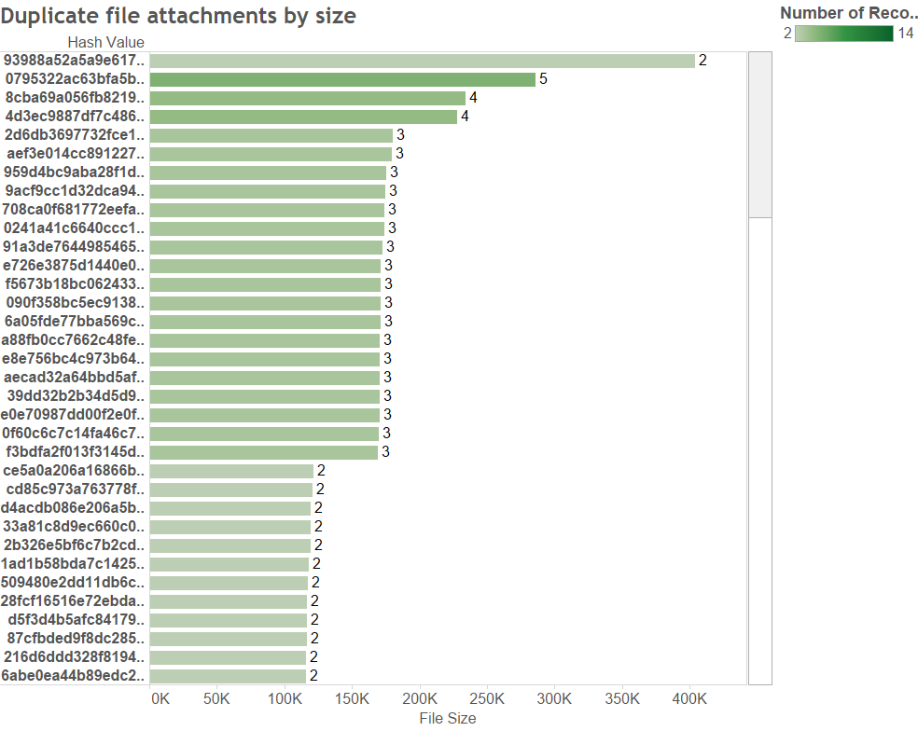
MD5 hash values for attachments in Partner Forum 2004

Slide 33
APARS - narrowing down and finding logical units
Start with everything on single document
Look at the document to see what is shown and the context
Dump all items to CSV to explore
Determine whether needs to be split or combinied
Narrow down “important” values
Include only numeric or quantifiable values you can identify
Exclude noise
Determine where splits or joins needed
In splits, see if multiple parallel values are needed – other values duplicated
DEMO

Slide 34
Bug reports - real world example
Multi-level logical units
Main document has bug report with simple and rich text items
Response document has status
Document with shared key from response has release info
Data Analysis
Quantifying and categorizing
Cognitive Analysis
Adds in narrative data for tone analysis, personality insights and natural language processing
DEMO

Slide 35
It’s all about the questions
Q1 – How many are severity 1 or 2?
Logical unit is Bug Report, so one row per document
Need severity value
DEMO

Slide 36
It’s all about the questions
Q2 – How many of those were SPR’d?
Logical unit is Bug Report plus a response document with status, so one row per combination of main and response
Need severity value from Bug Report
Need SPR number from the response document
DEMO

Slide 37
It’s all about the questions
Q3 – What percent of bugs reported to be “blocking deployment” were SPR’d?
Logical unit is Bug Report plus a response document with status, so one row per combination of main and response
Need parsed value from rich text on Bug Report
Need SPR number from the response document
DEMO

Slide 38
It’s all about the questions
Q4 – How many of those reported to be “blocking deployment” were released?
Logical unit is Bug Report plus a response document with status plus the matching document in Fix List db, so one row per combination of main and response and fixlist document
Need parsed value from rich text on Bug Report
Need SPR number from the response document
Need Maintenance Release which matches that SPR number
DEMO

Slide 39
It’s all about the questions
Q5 – How many of those reported to be “blocking deployment” were released?
Logical unit is Bug Report plus a response document with status plus the matching document in Fix List db, so one row per combination of main and response and fixlist document
Source is nine parallel databases
Need parsed value from rich text on Bug Report
Need SPR number from the response document
Need Maintenance Release which matches that SPR number
DEMO

Slide 40
Celebration time
You made it!
(at least I hope you did. Bueller? Bueller? Bueller?)

Slide 41
Q&A
http://geniisoft.com/db/MWLUG2017

Slide 42
More information

