Slide 1
Data Mining in the Mountains of Rich Text
AD103 - Friday, 3pm-4pm
Ben Langhinrichs
President of Genii Software

Slide 2
Ben Langhinrichs, Genii Software
Introduction

Slide 3
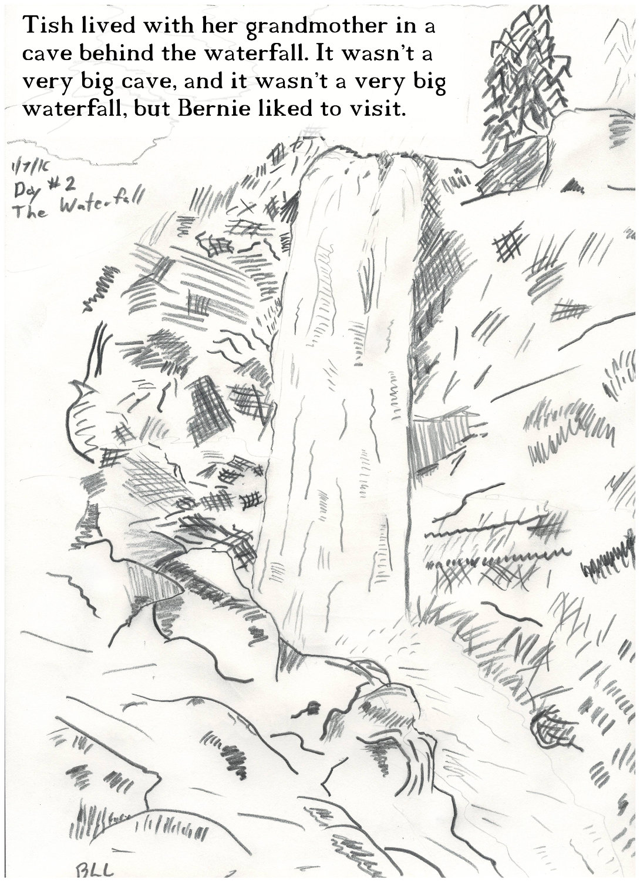
When I am not developing software, I write children’s books and draw pictures.

Slide 4
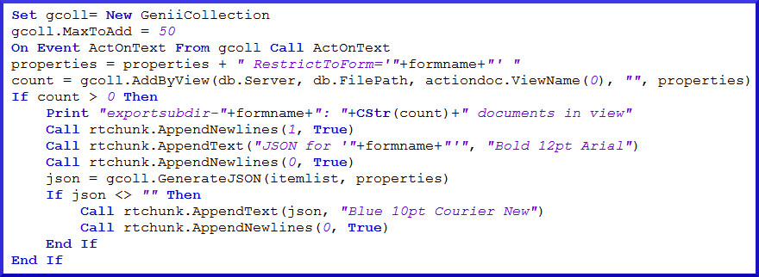
Midas LSX: Adding functionality to LotusScript since R4
Midas C++: Adding functionality to C++/Java/etc. since R5

Slide 5
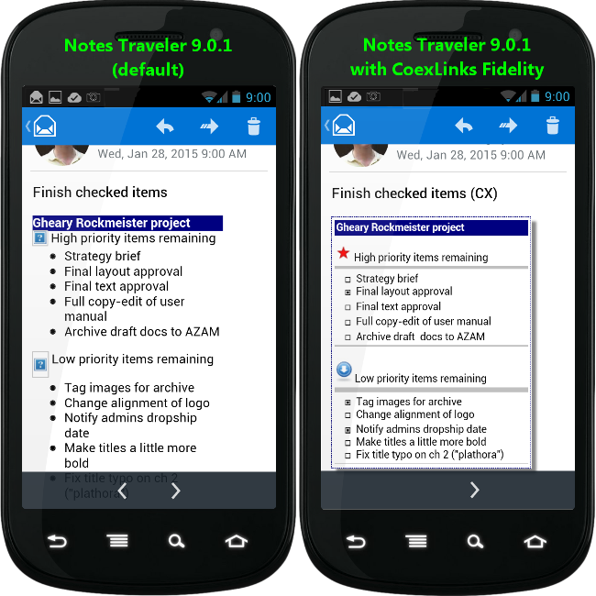
CoexLinks Fidelity: Because recipients should see what you sent

Slide 6
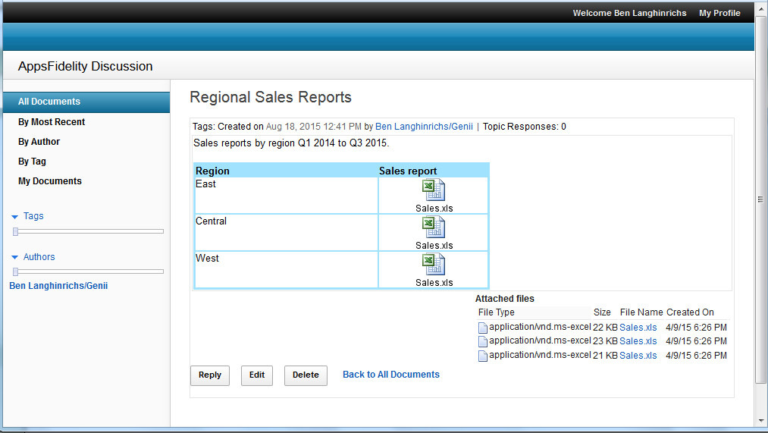
AppsFidelity: Because fidelity matters for applications, too

Slide 7
Data Mining in Rich Text. Really, how hard can it be?

Slide 8
Thoughts for session
Defining terms
Tools of the trade
Data visualization
Methods to extract data
Rich text elements to be mined
The data within the data
MD5 hashing as data analysis tool

Slide 9
Defining terms
Data mining: (n) the practice of examining large databases in order to generate new information.
Data visualization: (n) any effort to help people understand the significance of data by placing it in a visual context. Patterns, trends and correlations that might go undetected in text-based data can be exposed and recognized more easily with a visualization representation. Rich text: (n) The contents of all the rich text items, plus the contents of all the other items. It’s all really rich text at some level.

Slide 10
Data mining – 10 kilometers
If we stand back too far, we can’t see separate patterns

Slide 11
Data mining – 10 millimeters
If we dive in too close, the pattern is no longer visible

Slide 12
Data mining - 10 meters
The key is to discern patters from far enough away to see them, but not so far that the correlations are lost

Slide 13
Data visualization
Data visualization: (n) any effort to help people understand the significance of data by placing it in a visual context. Patterns, trends and correlations that might go undetected in text-based data can be exposed and recognized easier with data visualization software. Data visualization is about telling a story.

Slide 14
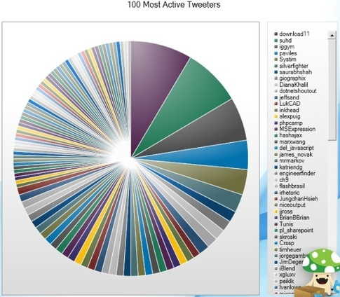
Data visualization
Too much data makes the story incomprehensible

Slide 15
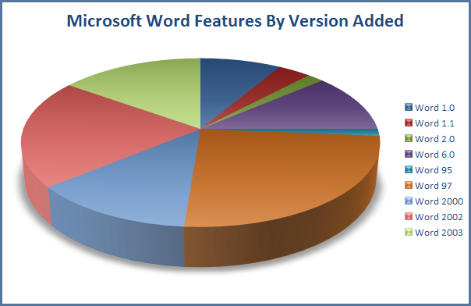
Data visualization
Simplify too much, and you lose the plot

Slide 16
Visualization example using Notes rich text data
Uses existing database (Partner Forum 2004)
Counts on familiarity of audience
Emphasizes most important data without showing every detail
Over 25,000 documents

Slide 17
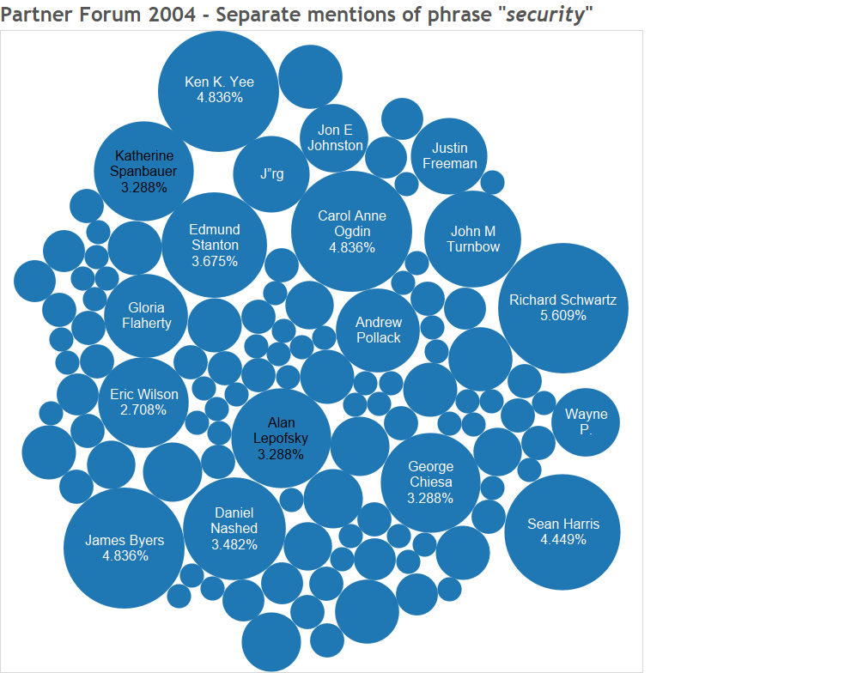

Slide 18
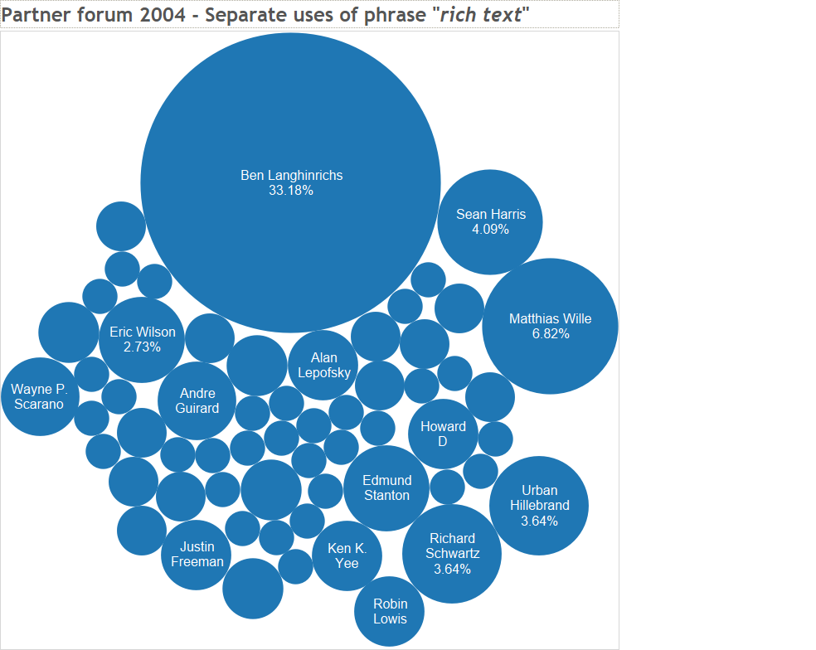

Slide 19
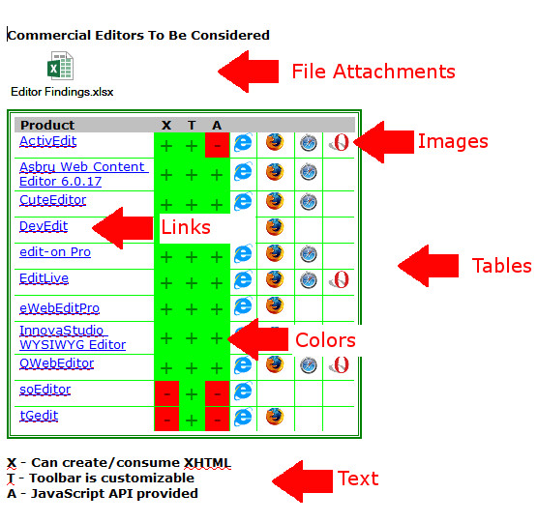
Mountains of Rich Text
Rich text: (n) The contents of all the rich text items…

Slide 20
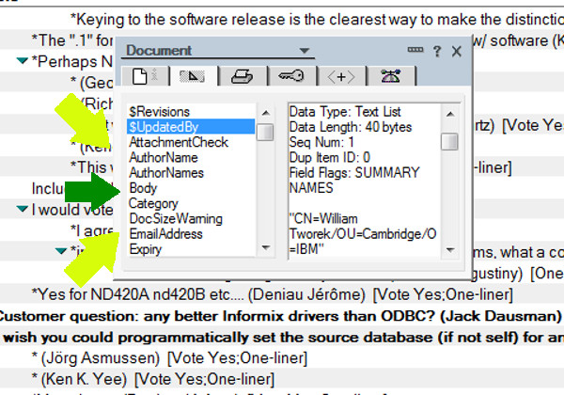
Mountains of Rich Text
Rich text: (n) …plus the contents of all the other items.

Slide 21
Unstructured to Structured
Notes data is technically unstructured
Some data is functionally structured
Some data is semi-structured
Some data is functionally unstructured
Data analytics needs structured data
Discrete values (names, categories, attributes)
Boolean values (yes/no, 0/1, black/white)
Numbers (it’s all about the numbers!)

Slide 22
Unstructured to Structured

Slide 23
Unstructured to Structured

Slide 24
Unstructured to Structured
And there is more
Quantity of each type of fruit
Total weight of each type of fruit
Age of each shipment, percentage bad, etc. etc. etc.

Slide 25
Unstructured to Structured
Let’s look at Help db
What is functionally structured?
Non-rich text items
Subject at top
Form information
What is semi-structured?
Related links at bottom
What is unstructured?
Rich text content

Slide 26
Unstructured to Structured
Let’s look at Help db
Don’t forget the meta-data
$UpdatedBy
$Revisions
Or the implicit meta-data (can be calculated)
Total size of the document
Number of characters in Body
Number of images
Number of documents which link to this document
Hierarchy (parent, children, siblings)

Slide 27
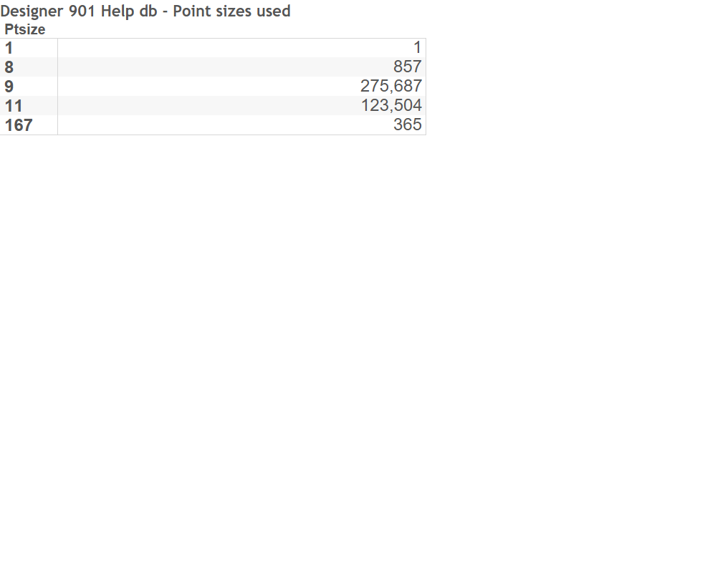
Help database example

Slide 28
Unstructured to Structured
Let’s look at Pinnacle East db
What is functionally structured?
Almost everything
Form tells you about structure
What is semi-structured?
Meta-data such as $UpdatedBy, activity log
What is unstructured?
Probably not much

Slide 29
Unstructured to Structured
Multi-database data
Product database showing items sold in Pinnacle East
A discussion database with links to Pinnacle East
Parallel databases Pinnacle West, Pinnacle Central

Slide 30
Rich Text
How to get at it
NotesRichText classes
DXL
Third party tools
C API
What to do with results
Work inside of Notes by saving structured data to separate items or documents in a report database
Work outside of Notes by extracting structure into CSV, JSON, SQL db or whatever

Slide 31
Rich Text Elements
Text records
The text value itself
Length of the text
Key words/phrases within the text (full text search)
Simple text attributes (bold, underline)
More complex text attributes (language tagging, character set)
Data mining
Easy to get at with everything from @Abstract to GetFormattedText method. Better to use through Paragraph than directly.
NotesRichTextItem and NotesRichTextStyle classes
DXL
C API

Slide 32
Rich Text Elements
Paragraphs
The text value of the paragraph
Whether it is part of an ordered or unordered list (bullets)
Display attributes (spacing, margins, etc.)
Data mining
Easy to get at most of it with NotesRichTextParagraph
More important than Text as fundamental unit of comprehension
DXL
C API
The primary goal of this demo is to help you think.

Slide 33
Rich Text Elements
Tables (ultimate in semi-structured frustration)
Text (and more) contents of cells
Number of rows, columns
Spanned cells
Nested tables
Tabbed tables (tab label used for categorization)
Widths of columns, cell attributes, table attributes, etc.
Data mining
Some parts easy to get via NotesRich Text classes, esp. text contents of cells which are most often used for data mining
Nested tables are a major gotcha
DXL
C API

Slide 34
Rich Text Elements
Sections (semi-structured by design in some dbs)
Text (and more) contents of section
Section title (can be computed)
Paragraph attributes, etc.
Data mining
Some parts easy to get via NotesRich Text classes, but mostly used as unit to categorization content within
See Help db example
DXL
C API

Slide 35
Rich Text Elements
URL Link Records
Text shown
URL
Type of link (http://, https://, notes://)
Target
Data from the linked resource
Data mining
Fairly easy to get at with NotesRichText classes. Sometimes useful for connection content and relationship data mining.
DXL
C API

Slide 36
URL Domains demo
Domains used in URL link hotspots
Directive in Notes
Demo in Tableau

Slide 37
Rich Text Elements
Image Records
Image type (Notes bitmap, GIF, JPG, PNG)
Image storage (inline, image resource, storage attachment)
Image size (bytes), dimensions (pixels), displayed dimensions (pixels or inches
Binary data
Meta-data (alt text, styles, borders, etc.)
Data mining
Difficult to get much, as there is little rich text class support
DXL
C API

Slide 38
Rich Text Elements
File attachments (part in rich text, part not)
File name (both internal and original)
File type (extension)
File storage (attached to rich text or only to document)
File size (bytes)
Binary data
Meta-data (alt text, mod dates, etc.)
Data mining
Difficult to get much of the rich text elements, but the attachment name and content is easy to get to from formula language or Notes classes
DXL
C API

Slide 39
Rich Text Elements
OLE objects
Like file attachments, but with less ability to access
Data mining
Difficult to get at in almost any form. Best bet is to have front end extraction to files that can be used.
C API (though even thin it is hard)

Slide 40
Rich Text Elements
MIME formatted rich text
Multiple parts, including images, attachments, HTML and/or plain text,etc.
Data mining
Easy to get text version of each part, but hard if you want/need to parse those contents. Basically, easy to get at images and attachments, but worth converting to rich text to get at most everything else
DXL
C API

Slide 41
Rich Text Elements
Other rich text elements
Layers
Layout regions and fields
Anchors (for those anchor links)
Stored forms
Embedded views and other elements
Etc., etc., etc.
Data mining
Mostly difficult to get at, and only rarely needed for data mining except in specific circumstances such as a database that relies on layout field values.
DXL (though often limited)
C API

Slide 42
Tools of the trade
There are various tools for finding data:
Notes views
Exporting a view to CSV
Extracting rich text elements with native Notes LotusScript and Java classes
Export to DXL and process as XML
Third party tools such as our Midas LSX
Analysis through screen scraping

Slide 43
Tools of the trade
Notes views - Pros
Easy to create
Categorization helps you put data in buckets
Formulas allow you to massage the data
You can export a view to CSV
Notes views - Cons
Only summary values available
One line per record
One record per line
Mostly a manual technique

Slide 44
Tools of the trade
Exporting a view to CSV
Easy to do
Make sure to save with .csv extension
Make sure to include column titles and make them unique and useful
Not categorization

Slide 45
Tools of the trade
Exporting rich text elements with Notes classes
Extract the parts you want and write out to CSV
Extract the parts you want and write to temp items or docs
Choose how to flatten multiple values

Slide 46
Tools of the trade
Exporting rich text elements with DXL
DXL is XML
Extract the field or range or whole document
Parse and process with SAX parser or Transform
Work either with XML or extract to CSV
Choose how to flatten multiple values

Slide 47
Tools of the trade
There are various tools for analyzing and visualizing data:
In place analysis with Notes agents
Excel and other spreadsheets
SQL systems that allow import of CSV or XML
Tableau and other data visualization tools

Slide 48
MD5 hashing
MD5 hash value
Widely available and easy to create
Security is not an issue here
Creates a unique 32-character string
Easy to use as a substitute category for complex data
Any arbitrary data can be compared, though it must be exactly the same.

Slide 49
MD5 hashing
MD5 hash value for attachments
Demo in Tableau

Slide 50
MD5 hashing
MD5 hash value for paragraphs of text
Demo in Tableau

Slide 51
Celebration time
You made it!
(at least those who didn’t quit half an hour ago to check FB)

Slide 52
Q&A
http://geniisoft.com/db/MWLUG2016

Slide 53
More information

