Slide 1
The ROI of Data Building on your company's existing investment
Ben Langhinrichs
President of Genii Software

Slide 2
Our Amazing Sponsors

Slide 3
Introduction
Ben Langhinrichs President, Genii Software
Author, thinker, poet, software designer

Slide 4
When I am not developing software, I write children’s books and draw pictures.
DANGER TASTES DREADFUL, fantasy adventure for 7-12 year olds, is due out August 14th from Clean Reads (but you can preorder now).

Slide 5
Genii Software products
CoexLinks family – high fidelity email
CoexLinks Fidelity – High fidelity email “live”
CoexLinks Migrate – High fidelity email exported
CoexLinks Journal – High fidelity email journaled to vaults
AppsFidelity family – high fidelity apps
AppsFidelity – Synchronized Notes/Web editing
AppsFidelity Migrate – Export application data
Midas family – extended programming in ND
Midas LSX – Data mining & export, rich text manipulation, and more
Midas C++ - Same Midas magic squeezed into a C/C++ bottle

Slide 6
Thoughts for session
Defining terms
What are the answers that provide value?
What are the logical units of information?
Data visualization
Data analysis with real world data

Slide 7
Defining terms
ROI: Return on Investment, or Re-use of Information you have already spent time, energy, and money creating and collection.
Data mining: digging into databases in order to find relevant information including context.
Data analysis: inspecting, cleaning, transforming, and modeling data with goal of discovering useful information, suggesting conclusions, and supporting decision-making
Data visualization: helping frame the significance of data by placing it in a visual context.
Machine learning: teaching computers to find hidden insights without being explicitly programmed where to look.

Slide 8
R O I

Slide 9
Return On Investment / Re-use of Information
Obvious to non-obvious (some may be external)
Active dbs with easily identifiable data points (e.g., sales records)
Archived dbs with easily identifiable data points (e.g., previous year’s orders)
Correlated dbs with less easily identifiable data (e.g., CRM or support dbs correlated with sales/products dbs)
Parallel but disconnected dbs (e.g., discussion, brainstorming)
Ancillary dbs with loosely correlated data (e.g., mail dbs)
Unrelated dbs used by correlated people (e.g., any other activity of people involved with correlated dbs)

Slide 10
Data Mining. Really, how hard can it be?

Slide 11
Data mining
Finding the data you know you need without losing the context of the data you might need.
You can’t process everything, but you don’t want to miss anything. Best is an approach that allows you to add/remove data from your analysis easily.

Slide 12
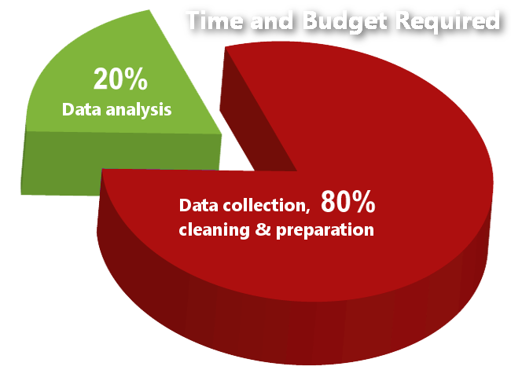
Data analysis
Answering questions and finding correlations based on numeric and quantitative analysis.

Slide 13
Data visualization
Telling a story in a way that allows viewers to understand an answer without doing the analysis themselves.

Slide 14
Machine learning / cognitive computing
Combining structured, unstructured and narrative data using natural language
The system learns as it is fed more data, so it can answer new questions & find new insights
Qualitative analysis with confidence rankings

Slide 15
Data mining - What are the questions?
Questions lead to answers. Key is getting to the questions that mean something to the specific audience. Admins, Developers, Users, Managers, C-Level all have different questions which may rely on overlapping sets of data.
Answers lead to questions. The more users see specific questions answered by data, the more questions will spring to mind. You may have to prime the pump.

Slide 16
Data mining - Logical units of information

Slide 17
Data mining - Methods to extract data
How to get at it
LotusScript classes including NotesRichText classes
Domino Access Services (REST URL stuff)
DXL
Third party tools & services
C API
What to do with results
Work inside of Notes by saving structured data to separate items or documents in a report database
Work outside of Notes by extracting structure into CSV, JSON, SQL db or whatever

Slide 18
Data visualization example (using Notes rich text data)
Uses existing database (Partner Forum 2004)
Counts on familiarity of audience
Emphasizes most important data without showing every detail
Over 25,000 documents

Slide 19
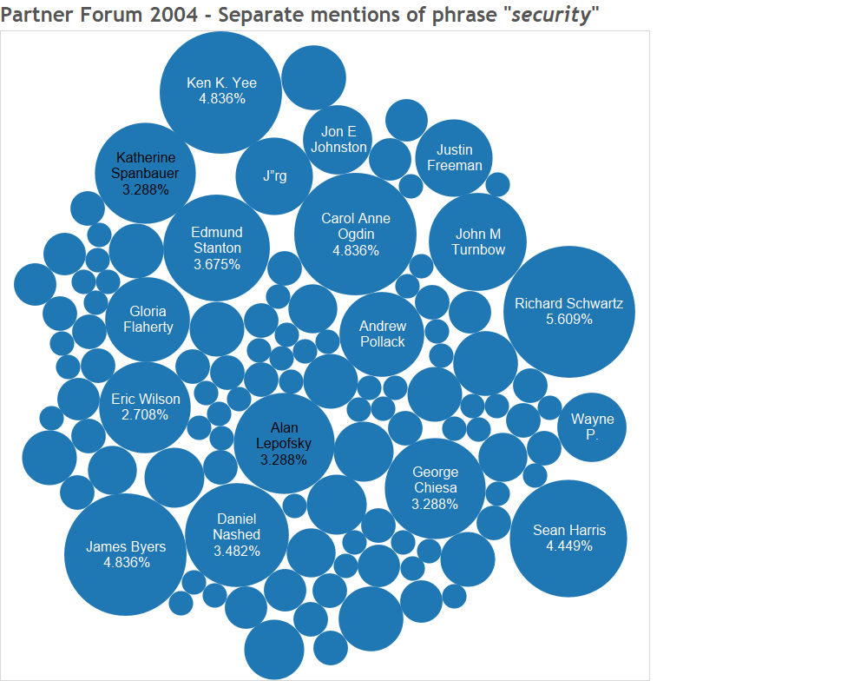
Visualization example

Slide 20
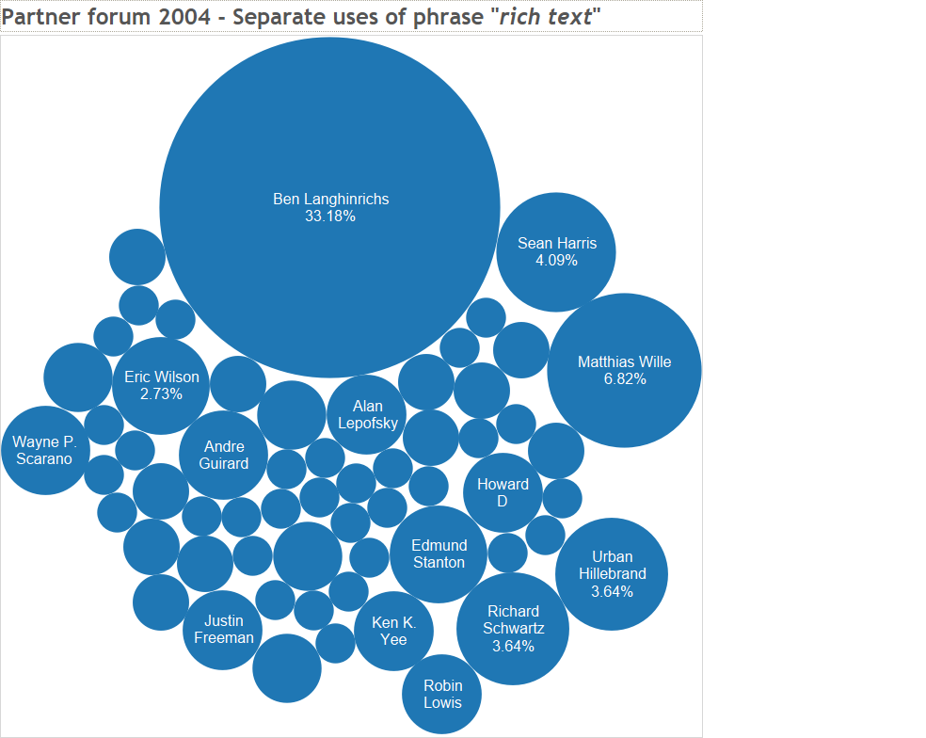
Visualization example

Slide 21
Customer example
Services company with
About 4000 users (involved in this analysis)
18 databases (discussions, Q&A, etc. not correlated)
Wanted to pre-populate interests/skills inventory
Included selected text fields (including subject) and rich text fields to find who talked about what the most.
Biggest problem was coming up with synonyms for skills (what terms relate to ‘security’) without overcounting
Identified new questions relating to ‘top contributors’

Slide 22
Visualization example
Specific experts

Slide 23
Visualization example
Top tier of contributors

Slide 24
Unstructured to Structured
Notes data is technically unstructured
Some data is functionally structured
Some data is semi-structured
Some data is functionally unstructured
Data analytics needs structured data
Discrete values (names, categories, attributes)
Boolean values (yes/no, 0/1, black/white)
Numbers (it’s all about the numbers!)

Slide 25
Unstructured to Structured

Slide 26
Unstructured to Structured

Slide 27
Unstructured to Structured
Don’t forget the related data
Quantity of each type of fruit
Total weight of each type of fruit
Age of each shipment, percentage bad, etc. etc. etc.

Slide 28
Special considerations for Notes data
Temporary normalizing: trimming, same casing, elimination of punctuation/paragraphs
I am Superman.
“I AM” Superman
I am SUPERMAN!
I am SUPERMAN!
All become [I am superman]
Multi-value items: may need to separate and duplicate other values
Rendering: can minimize implementation differences in some cases

Slide 29
Customer example
Canadian company with extensive historical textual data
Wanted to create suggestion list for bullet items
Collection of all bullet lists stripped (temporarily normalized) and rendered to MD5 hash
When a user selected a bullet item, they could pop up a set of other points made when that was made

Slide 30
Multi-Value Logical units in documents
Fields
Separate fields could be separate units
Multi-value field could be one unit per value (especially linked to other documents)
Rich text
Sections
Tables or table rows
Paragraphs
List items
Images
Attachments, including contents

Slide 31
Narrative data for Cognitive Analysis
Thursday, oranges were twice the price of the week before, and the quality was iffy. Supplier told us that Hurricane Rohit wiped out most of the citrus crop. On the other hand, they had some good Granny Smith and Macintosh apples, so we doubled up to 40 crates on those and only got three of oranges. We need to get an apple pie recipe in the weekly flier. – Ron in purchasing
Granny Smiths are very tart, but Janice found a recipe which uses them. If it works, we’ll double up on apples next week as well. – Javier (supervisor)

Slide 32
Tools of the trade
There are various tools for finding data:
Notes views
Exporting a view to CSV
Generating customized JSON with an agent
Generating JSON with Domino Access Services URLs (REST)
Extracting rich text elements with native Notes LotusScript and Java classes
Export to DXL and process as XML
Third party tools such as our Midas LSX
Analysis through screen scraping

Slide 33
Tools of the trade
Notes views - Pros
Easy to create
Categorization helps you put data in buckets
Formulas allow you to massage the data
You can export a view to CSV
Notes views - Cons
Only summary values available
One line per record
One record per line
Mostly a manual technique

Slide 34
Tools of the trade
Exporting a view to CSV
Easy to do
Make sure to save with .csv extension
Make sure to include column titles and make them unique and useful
Not categorization

Slide 35
Tools of the trade
Generating customized JSON with an agent
Fairly easy to do
Very flexible, as you can pull data from anywhere
Possible to use view to generate some field values
Name the agent with a .json extension for opaque use
All data must be carefully massaged to get clean JSON
Fairly static, requiring developer assistance to modify

Slide 36
Tools of the trade
Generating JSON with Domino Access Services
Easy to do
Pretty much get everything
Requires permissions for everything
Security issues above my pay grade

Slide 37
Tools of the trade
Exporting rich text elements with Notes classes
Extract the parts you want and write out to CSV or JSON
Extract the parts you want and write to temp items or docs
Choose how to flatten multiple values (discuss!)

Slide 38
Tools of the trade
Exporting rich text elements with DXL
DXL is XML
Extract the field or range or whole document
Parse and process with SAX parser or Transform
Work either with XML or extract to CSV
Choose how to flatten multiple values

Slide 39
Tools of the trade
There are various tools for analyzing and visualizing data:
In place analysis with Notes agents
Excel and other spreadsheets
SQL systems that allow import of CSV or XML
Power BI, Excel, Tableau and other data visualization tools

Slide 40
Metadata is still data
Metadata about process:
Creation/modification timestamps (with day-of-week, time-of-day translations adjusted for time zones)
Authors, readers
Access control as data
Document, image, attachment, text data sizes

Slide 41
Representational keywords
MD5 hash value
Widely available and easy to create
Security is not an issue here
Creates a unique 32-character string
Easy to use as a substitute category for complex data
Any arbitrary data can be compared, though it must be exactly the same.
Replica ID and Note unique ids
Easily available, but anonymous to those without source access
Easy to get back to original for those with source access.

Slide 42
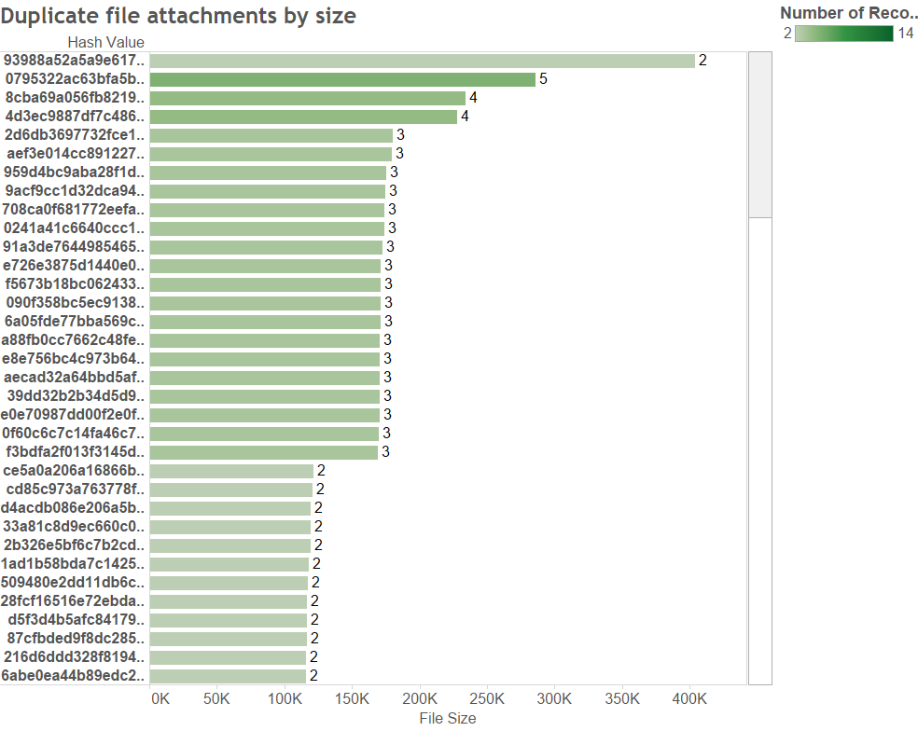
MD5 hash values for attachments in Partner Forum 2004

Slide 43
Customer example
Company modernizing had two goals
Find duplicate images to consolidate references and reduce bandwidth and storage
Provide mechanism for finding images in cases of alleged copyright infringement
Process
Generated CSV with all image resources and all images embedded in rich text fields (later added some embedded in design elements)
Generated MD5 hash of every image as key, along with its location and size (to prioritize frequently used images that were larger)

Slide 44
APARS - narrowing down and finding logical units
Start with everything on single document
Look at the document to see what is shown and the context
Dump all items to CSV to explore
Determine whether needs to be split or combined
Narrow down “important” values
Include only numeric or quantifiable values you can identify
Exclude noise
Determine where splits or joins needed
In splits, see if multiple parallel values are needed – other values duplicated

Slide 45
Bug reports - real world example
Multi-level logical units
Main document has bug report with simple and rich text items
Response document has status
Document with shared key from response has release info
Data Analysis
Quantifying and categorizing
Cognitive Analysis
Adds in narrative data for tone analysis, personality insights and natural language processing

Slide 46
It’s all about the questions
Q1 – How many are severity 1 or 2?
Logical unit is Bug Report, so one row per document
Need severity value

Slide 47
It’s all about the questions
Q2 – How many of those were SPR’d?
Logical unit is Bug Report plus a response document with status, so one row per combination of main and response
Need severity value from Bug Report
Need SPR number from the response document

Slide 48
It’s all about the questions
Q3 – What percent of bugs reported to be “blocking deployment” were SPR’d?
Logical unit is Bug Report plus a response document with status, so one row per combination of main and response
Need parsed value from rich text on Bug Report
Need SPR number from the response document

Slide 49
It’s all about the questions
Q4 – How many of those reported to be “blocking deployment” were released?
Logical unit is Bug Report plus a response document with status plus the matching document in Fix List db, so one row per combination of main and response and fixlist document
Need parsed value from rich text on Bug Report
Need SPR number from the response document
Need Maintenance Release which matches that SPR number

Slide 50
It’s all about the questions
Q5 – How many of those reported to be “blocking deployment” were released?
Logical unit is Bug Report plus a response document with status plus the matching document in Fix List db, so one row per combination of main and response and fixlist document
Source is nine parallel databases
Need parsed value from rich text on Bug Report
Need SPR number from the response document
Need Maintenance Release which matches that SPR number

Slide 51
Is he done yet?

Slide 52
Q&A
http://geniisoft.com/db/CollabSphere2018

